Slide 1


Nguyễn Thanh Tùng
Thursday, May 4, 2023

Slide 2

Outline
Executive Summary
Introduction
Methodology
Results
Conclusion
Appendix

Slide 3
Executive Summary
Summary of methodologies
Summary of all results

Slide 4
Introduction
Project background and context
Problems you want to find answers

Slide 5

Section 1

Slide 6
Methodology
Executive Summary
Data collection methodology:
The libraries used are requests, pandas, numpy, and datetime. Helper functions are defined to extract information from the SpaceX API, including booster name, launch site name and coordinates, payload mass and orbit, spacecraft information, and landing outcome. The data is collected from the SpaceX API.
Perform data wrangling
Describe how data was processed
Perform exploratory data analysis (EDA) using visualization and SQL
Perform interactive visual analytics using Folium and Plotly Dash
Perform predictive analysis using classification models
How to build, tune, evaluate classification models

Slide 7
Data Collection
Describe how data sets were collected.
You need to present your data collection process use key phrases and flowcharts

Slide 8
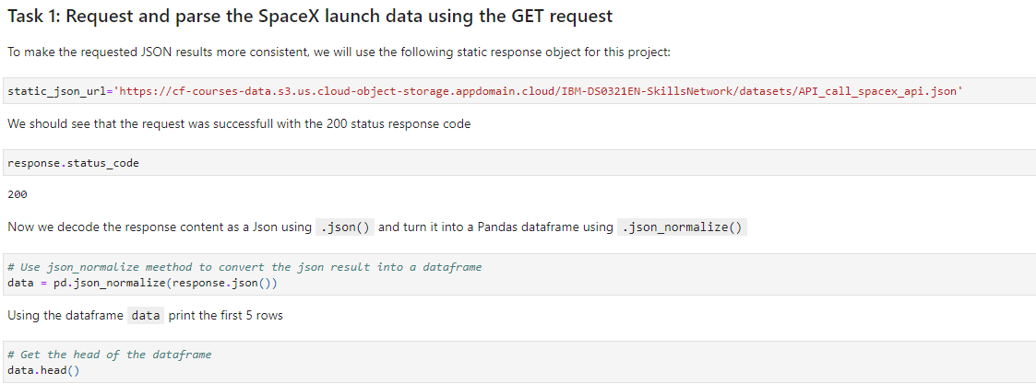
Data Collection – SpaceX API
We used the get request to the SpaceX API to collect data, clean the requested data and did some basic data wrangling and formatting
https://github.com/Tunggbe/SpaceY/blob/main/SpaceY/Week%201/Collecting%20the%20data.ipynb
Place your flowchart of SpaceX API calls here

Slide 9
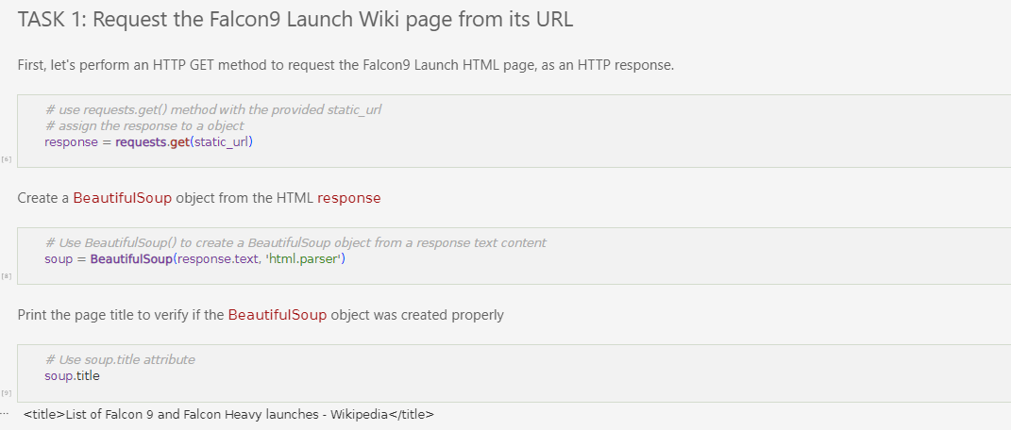
Data Collection - Scraping
We applied web scrapping to webscraping Falcon 9 launch records with BeautifulShoup
https://github.com/Tunggbe/SpaceY/blob/main/SpaceY/Week%201/Collecting%20the%20data.ipynb
Place your flowchart of web scraping here

Slide 10
Data Wrangling
We performed exploratory data analysis and determined the training labels
We calculated the number of launches at each site, and number and occurrence of each orbits
We created landing outcome label from outcome column and exported the results to csv
https://github.com/Tunggbe/SpaceY/blob/main/SpaceY/Week%201/Data%20Wrangling.ipynb

Slide 11
EDA with Data Visualization
We explored the data by visualizing the relationship between flight number and launch Site, payload and launch site, success rate of each orbit type, flight number and orbit type, the launch success yearly trend
https://github.com/Tunggbe/SpaceY/blob/main/SpaceY/Week%202/the%20EDA%20with%20Visualization%20lab.ipynb

Slide 12
EDA with SQL
Selected all columns from the "SPACEXTBL" table.
Selected distinct values in the "LAUNCH_SITE" column from the "SPACEXTBL" table.
Selected the "LAUNCH_SITE" column from the "SPACEXTBL" table where the "Launch_Site" column contains the string "CCA".
Calculated the sum of the "PAYLOAD_MASS__KG_" column in the "SPACEXTBL" table.
Calculated the average of the "PAYLOAD_MASS__KG_" column in the "SPACEXTBL" table where the "Booster_Version" column contains the string "F9 v1.1".
Selected the "BOOSTER_VERSION" column from the "SPACEXTBL" table where the "Landing Outcome" column contains the string "Success (drone ship)" and the "PAYLOAD_MASS__KG" column is between 4000 and 6000.
Counted the number of occurrences of each distinct value in the "Mission_Outcome" column from the "SPACEXTBL" table.
Selected the "Payload" and "PAYLOAD_MASS__KG_" columns from the "SPACEXTBL" table where the "PAYLOAD_MASS__KG_" column has the maximum value.
Selected the "Booster_Version" and "Launch_site" columns from the "SPACEXTBL" table where the "Landing _Outcome" column contains the string "Failure (drone ship)" and the year in the "Date" column is 2015.
Selected the "Date", "Booster_Version", and "Landing _Outcome" columns from the "SP”
https://github.com/Tunggbe/SpaceY/blob/main/SpaceY/Week%202/jupyter-labs-eda-sql-coursera_sqllite.ipynb

Slide 13
Build an Interactive Map with Folium
We marked all launch sites and added map objects such as markers, circles, and lines to indicate the success or failure of launches for each site on the Folium map.
We assigned the launch outcomes (failure or success) to class 0 and 1, i.e., 0 for failure and 1 for success.
Using color-labeled marker clusters, we identified which launch sites have a relatively high success rate.
We also calculated the distances between launch sites and their proximities, answering questions such as:
Are launch sites near railways, highways, and coastlines?
Do launch sites keep a certain distance away from cities?
https://github.com/Tunggbe/SpaceY/blob/main/SpaceY/Week%203/spacex_dash_app.py

Slide 14
Build a Dashboard with Plotly Dash
We bullt an interactive dashboard with Plotly dash
We plotted pie charts showing the total launches by a certain sites
We plotted scatter graph showing the relationship with Outcome and PayloadMass (Kg) for the different booster version.
https://github.com/Tunggbe/SpaceY/blob/main/SpaceY/Week%203/spacex_dash_app.py

Slide 15
Predictive Analysis (Classification)
We loaded the data using numpy and pandas, transformed the data, split our data into training and testing.
We built different machine learning models and tune different hyperparameters using GridSearchCV.
We used accuracy as the metric for our model, improved the model using feature engineering and algorithm tuning.
We found the best performing classification model.
https://github.com/Tunggbe/SpaceY/blob/main/SpaceY/Week%204/IBM-DS0321EN-SkillsNetwork_labs_module_4_SpaceX_Machine_Learning_Prediction_Part_5.jupyterlite.ipynb

Slide 16
Results
Exploratory data analysis results
Interactive analytics demo in screenshots
Predictive analysis results

Slide 17

Section 2

Slide 18
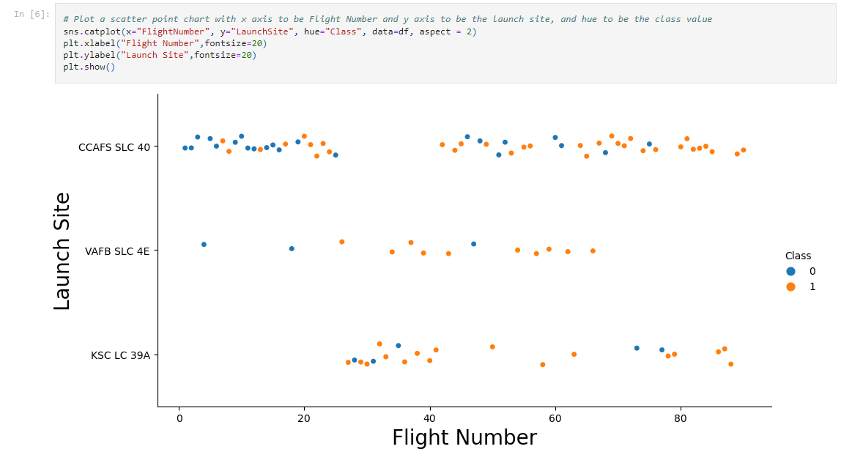
Flight Number vs. Launch Site
From the plot, we found that the larger the flight amount at a launch site, the greater the success rate at a launch site.

Slide 19
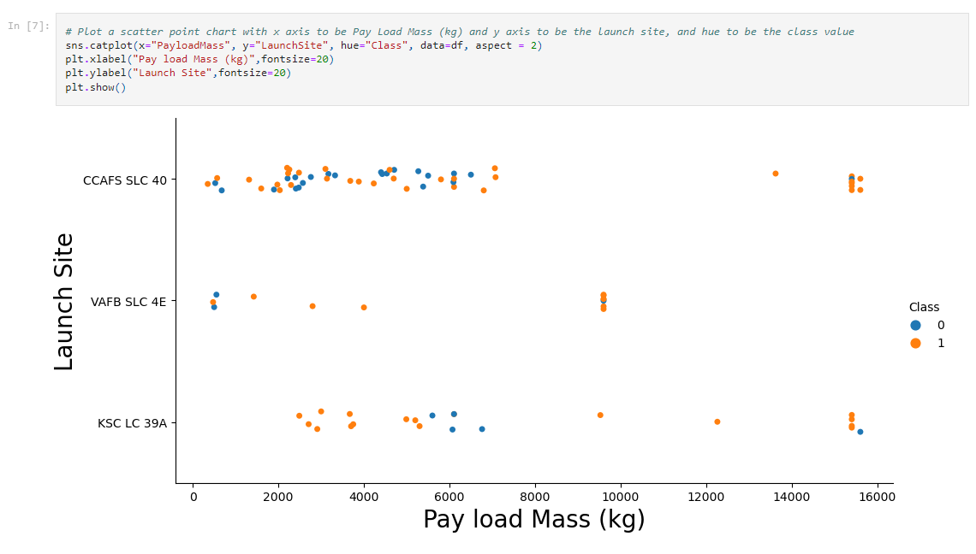
Payload vs. Launch Site
The greater the payload mass for launch site CCAFS SLC 40 the higher the success rate for the rocket.

Slide 20
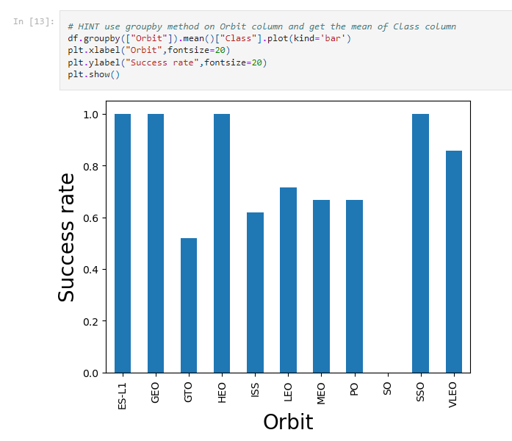
Success Rate vs. Orbit Type
From the plot, we can see that ES-L1, GEO, HEO, and SSO had the highest success rates, while SO had the lowest.

Slide 21
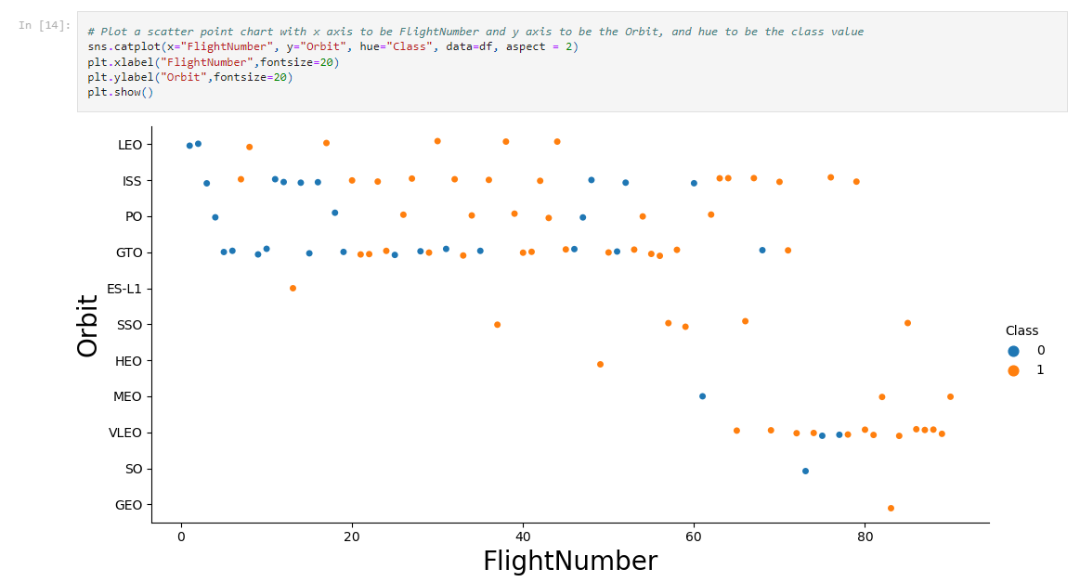
Flight Number vs. Orbit Type
The plot below displays the relationship between Flight Number and Orbit type. We can see that for LEO orbits, the success rate appears to increase with the number of flights, while for GTO orbits, there seems to be no correlation between the number of flights and success rate.

Slide 22
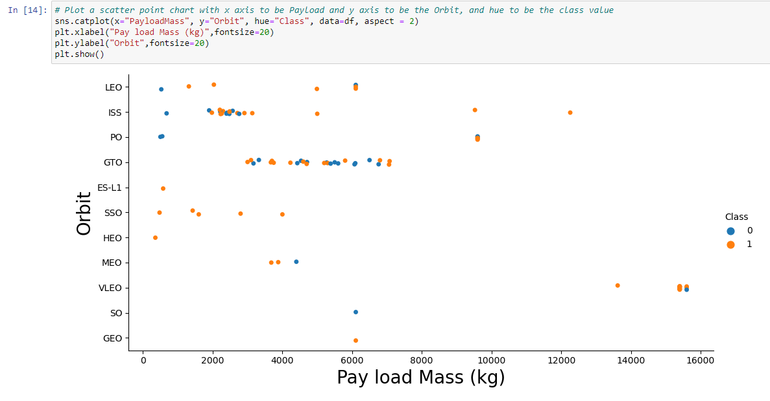
Payload vs. Orbit Type
The following plot displays the relationship between Flight Number and Orbit Type. It can be observed that in the LEO orbit, the success rate is positively correlated with the number of flights, while in the GTO orbit, there is no apparent relationship between the two variables.

Slide 23
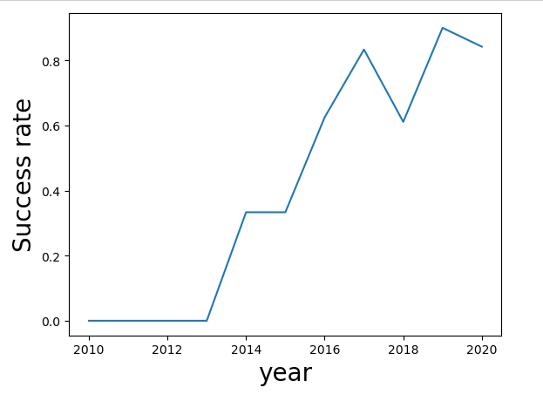
Launch Success Yearly Trend
We can observe that for heavy payloads, successful landings are more likely to occur in the PO, LEO, and ISS orbits.

Slide 24
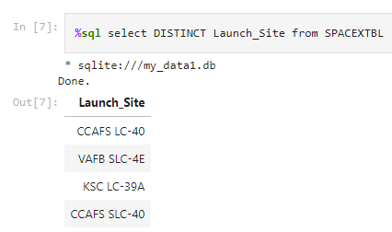
All Launch Site Names
We used the key word DISTINCT to show only unique launch sites from the SpaceX

Slide 25
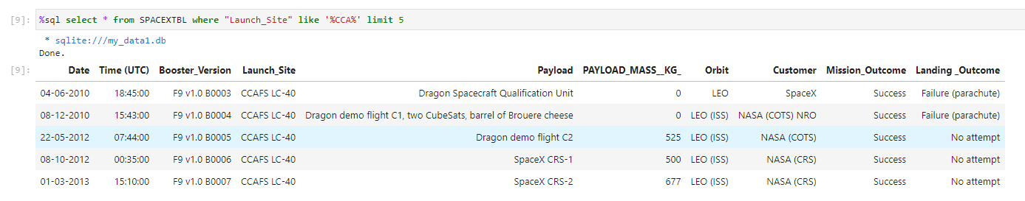
Launch Site Names Begin with 'CCA'
We utilized the query above to show 5 records with launch sites starting with 'CCA'.

Slide 26
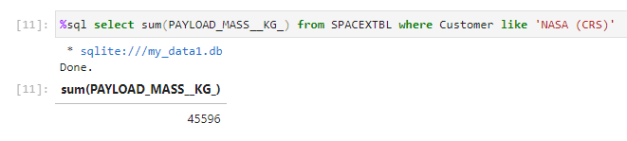
Total Payload Mass
We calculated the total payload carried by boosters from NASA as 45596using the query below

Slide 27
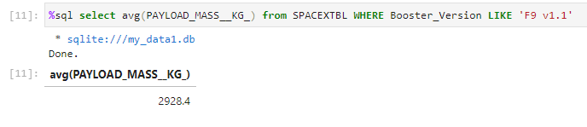
Average Payload Mass by F9 v1.1
We calculated the average payload mass carried by booster version F9 v1.1 as 2928.4

Slide 28
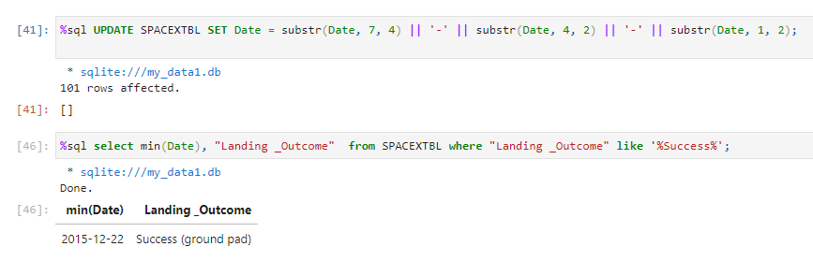
First Successful Ground Landing Date
We observed that the dates of the first successful landing outcome on ground pad was 22nd December 2015

Slide 29
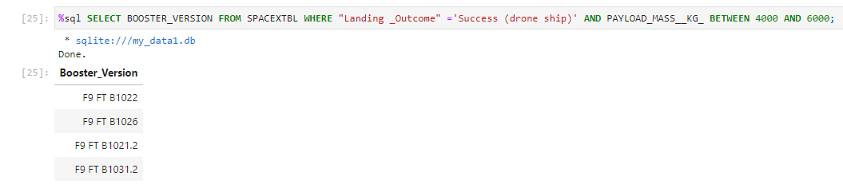
Successful Drone Ship Landing with Payload between 4000 and 6000

Slide 30
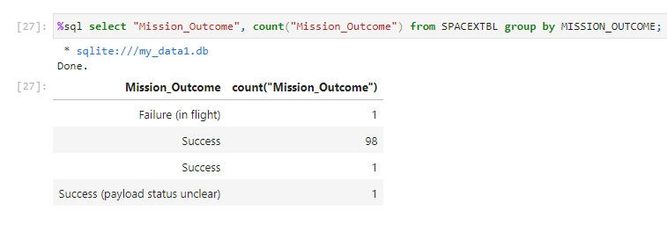
Total Number of Successful and Failure Mission Outcomes
We used wildcard like '%’ to filter for WHERE Mission_Outcome was a success or a failure.

Slide 31
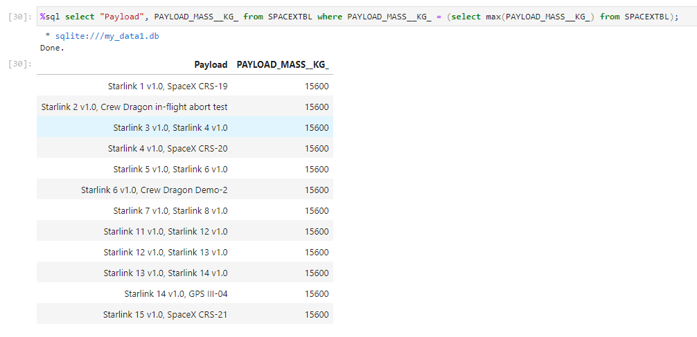
Boosters Carried Maximum Payload
We determined the booster that have carried the maximum payload using a subquery in the WHERE clause and the MAX() function.

Slide 32
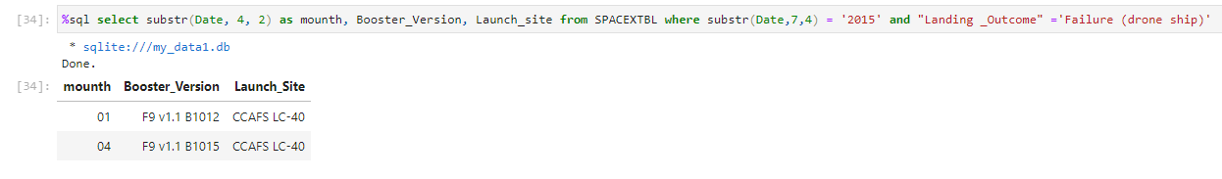
2015 Launch Records
We used a combination of the WHERE clause, LIKE, AND, and BETWEEN conditions to filter for failed landing outcomes of drone ships, their booster versions, and launch site names for the year 2015.

Slide 33
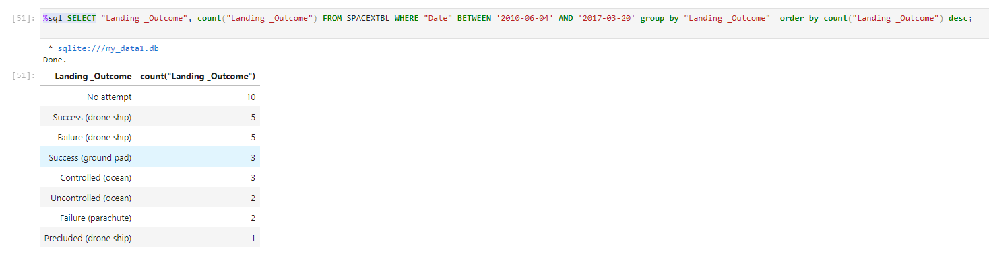
Rank Landing Outcomes Between 2010-06-04 and 2017-03-20
We selected Landing outcomes and the COUNT of landing outcomes from the data and used the WHERE clause to filter for landing outcomes BETWEEN 2010-06-04 to 2010-03-20.
We applied the GROUP BY clause to group the landing outcomes and the ORDER BY clause to order the grouped landing outcome in descending order.

Slide 34

Section 3

Slide 35
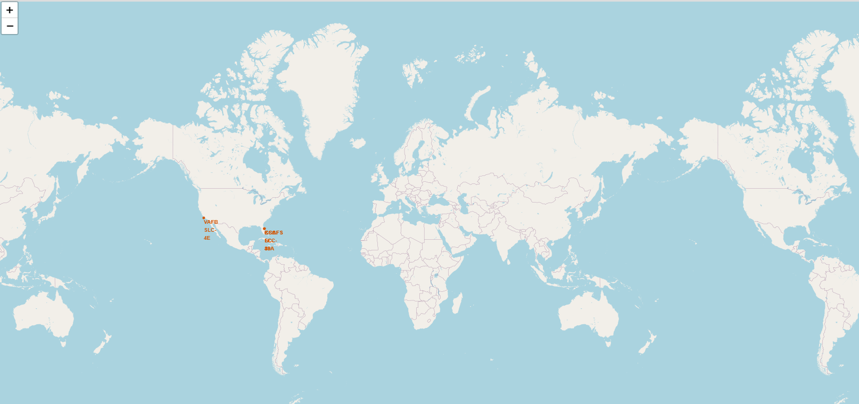
All launch sites global map markers
Replace <Folium map screenshot 1> title with an appropriate title
Explore the generated folium map and make a proper screenshot to include all launch sites’ location markers on a global map
Explain the important elements and findings on the screenshot

Slide 36
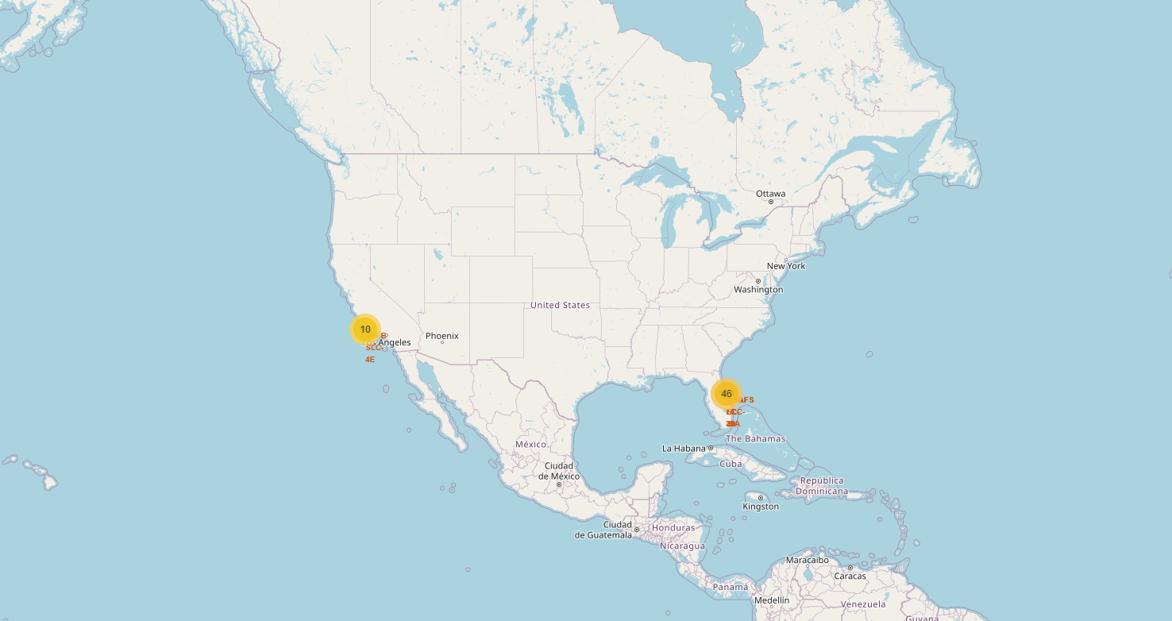
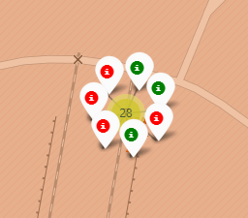
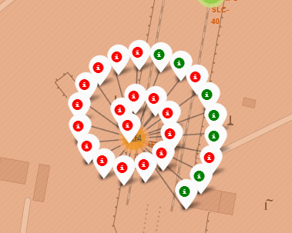
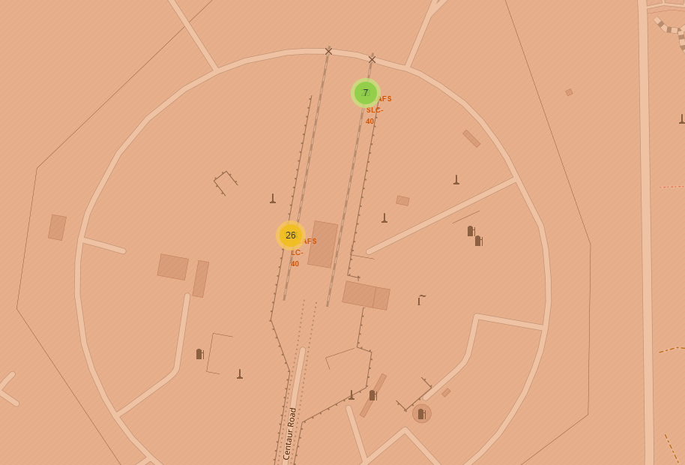
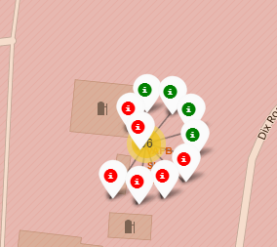
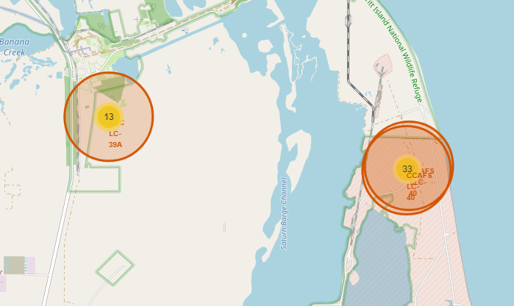
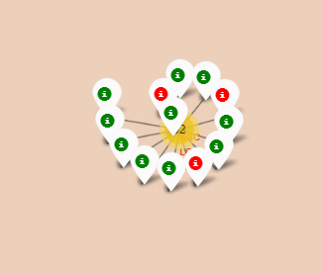
Markers showing launch sites with color labels
Replace <Folium map screenshot 2> title with an appropriate title
Explore the folium map and make a proper screenshot to show the color-labeled launch outcomes on the map
Explain the important elements and findings on the screenshot

Slide 37
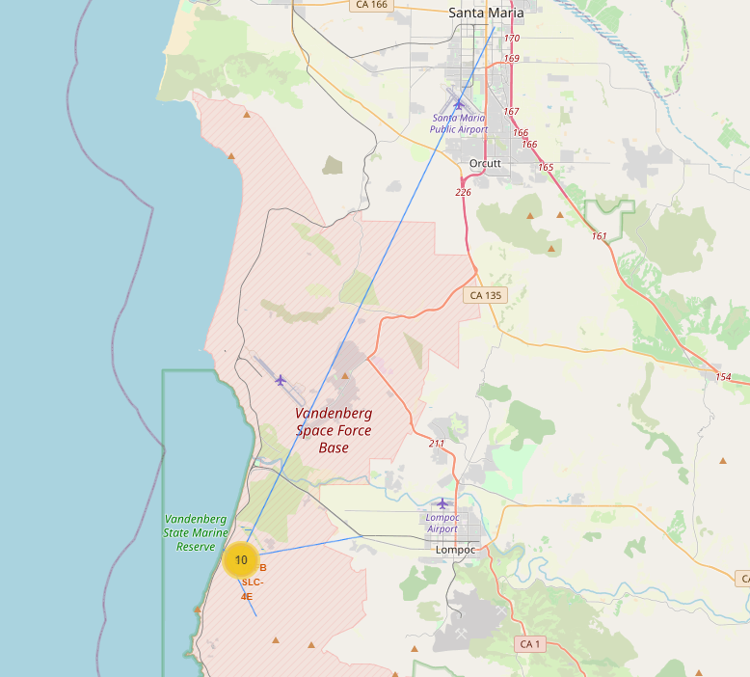
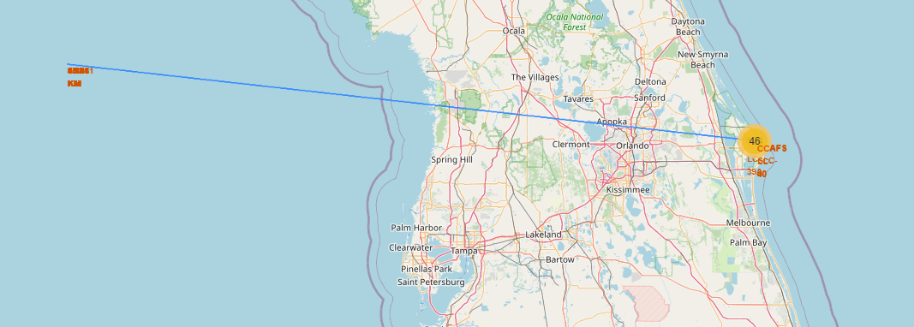
Launch Site distance to landmarks

Slide 38

Section 4

Slide 39
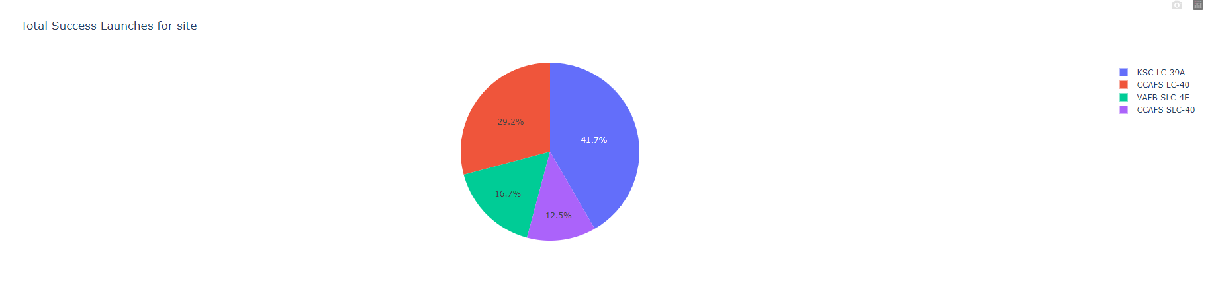
Pie chart showing the success percentage achieved by each launch site
Replace <Dashboard screenshot 1> title with an appropriate title
Show the screenshot of launch success count for all sites, in a piechart
Explain the important elements and findings on the screenshot

Slide 40
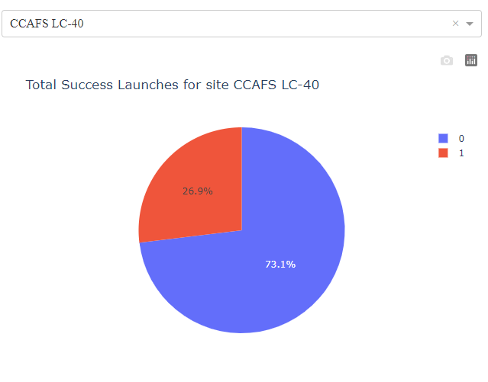
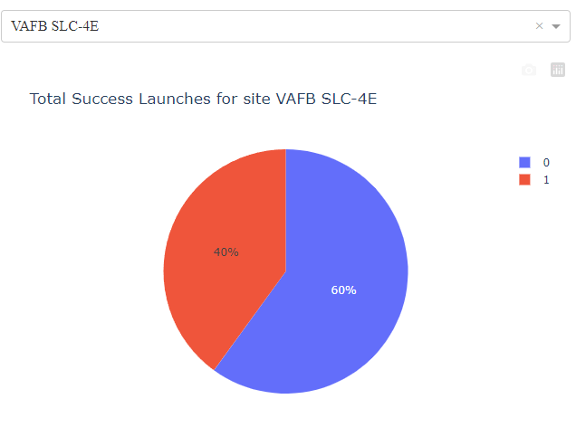
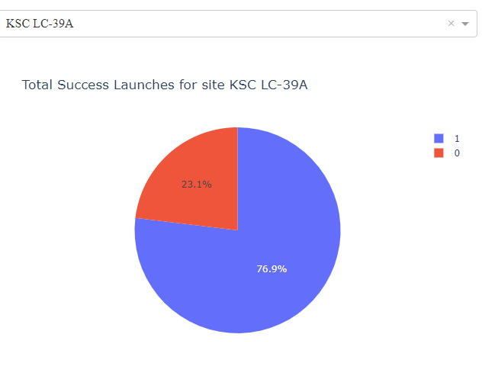
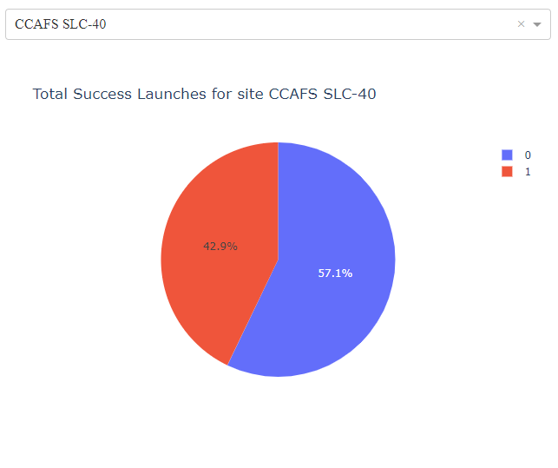

Slide 41
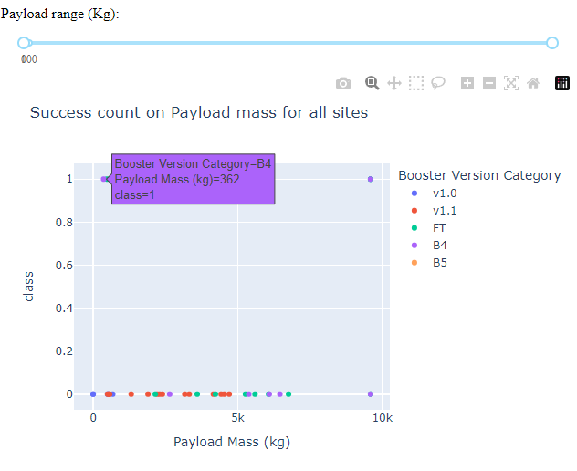
Scatter plot of Payload vs Launch Outcome for all sites, with different payload selected in the range slider

Slide 42

Section 5

Slide 43
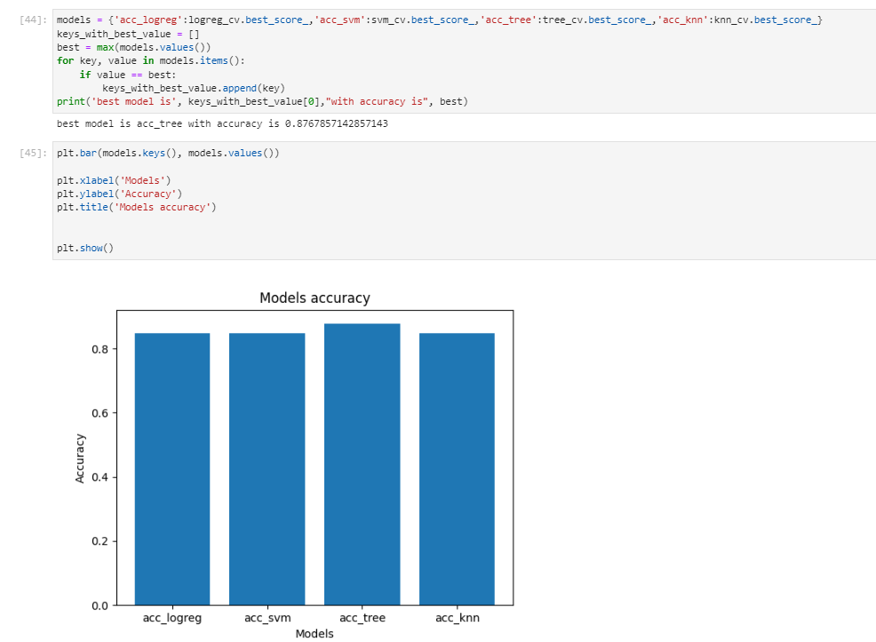
Classification Accuracy
Visualize the built model accuracy for all built classification models, in a bar chart
Find which model has the highest classification accuracy

Slide 44
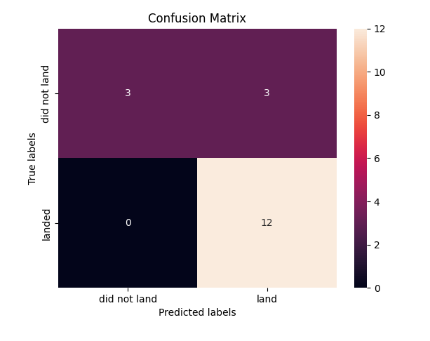
Confusion Matrix
The confusion matrix for the decision tree classifier indicates that the classifier is capable of distinguishing between the various classes. However, the primary issue lies in the false positives, where unsuccessful landings are incorrectly identified as successful landings by the classifier.

Slide 45
Conclusions
We can draw the following conclusions:
• The higher the number of flights from a launch site, the higher the success rate at that site.
• The launch success rate has been on the rise from 2013 to 2020.
• Orbits ES-L1, GEO, HEO, SSO, and VLEO have the highest success rates.
• KSC LC-39A has the most successful launches of any launch site.
• The decision tree classifier is the best machine learning algorithm for this task.

Slide 46


